Slide 1
Optical sensors
Optical sensors are electronic devices that use light to detect changes in a physical environment. These sensors are designed to detect and measure changes in light intensity, color, or wavelength, and convert them into electrical signals.
Types:
Active sensors and Passive sensors.
Application:
Automotive, aerospace, consumer electronics, and healthcare.
Proximity sensing, motion detection, color sensing, and gas sensing.

Slide 2
Advantages: High accuracy, low power consumption, and immunity to electromagnetic interference
1.Photo Emissive Transducers, also known as photo emissive detectors or photomultipliers, are electronic devices that convert light energy into electrical signals.
They consist of a photocathode, a series of electron amplification stages, and an anode.
When light falls on the photocathode, electrons are emitted and accelerated by an electric field towards the first dynode, which is held at a higher potential.

Slide 3
The impact of the electrons on the dynode releases more electrons, which are then accelerated towards the next dynode.
This process continues through several stages, resulting in a cascade of electrons that produces a large number of electrons at the anode.
The resulting electrical signal is proportional to the amount of light falling on the photocathode.

Slide 4
Photo emissive transducers have a high sensitivity to light and can detect low levels of light with a high signal-to-noise ratio.
Applications:
Scientific instruments
Medical equipment.
Night vision devices.

Slide 5
2.Photoconductive transducers:
It convert light energy into electrical energy by exploiting the property of certain materials to become more conductive when exposed to light.
Photoconductive materials typically have a high resistance in the dark, but their resistance decreases when light is absorbed.
This change in resistance can be used to generate an electrical signal that corresponds to the intensity of the incident light.
Applications:
Light sensors
Photodetectors
Image sensors.
Digital cameras,
Photocopiers
Imaging systems.

Slide 6
Photoconductive material:
Cadmium sulfide (CdS), which is often used in light-dependent resistors (LDRs) or photoresistors.
Lead sulfide (PbS), lead selenide (PbSe)
Silicon (Si), which is used in photodiodes and CCDs (charge-coupled devices).

Slide 7
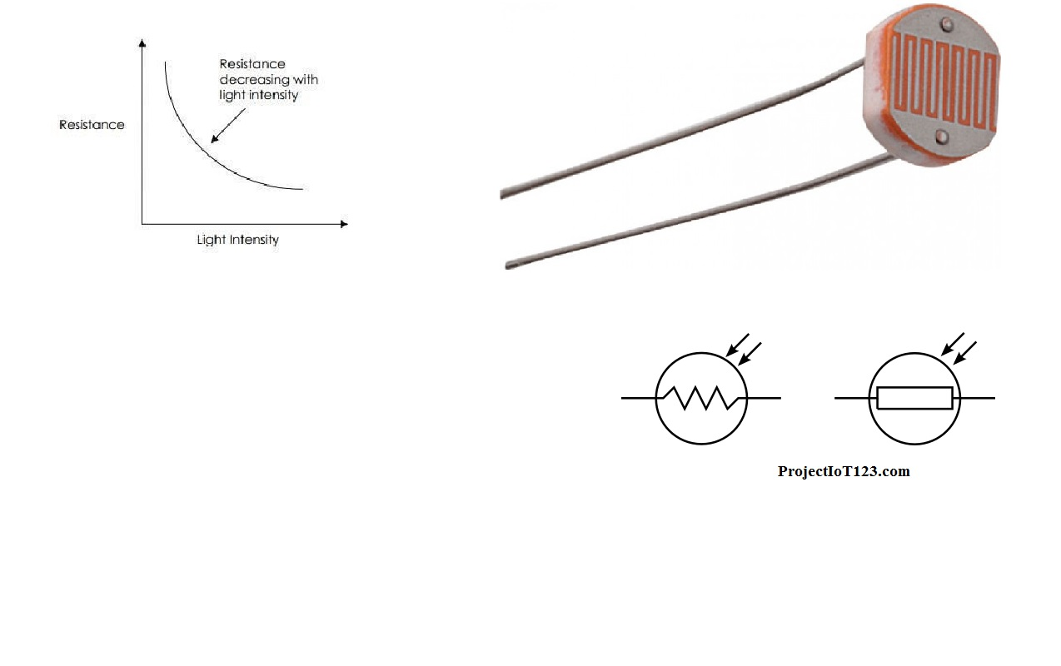
Characteristics:

Slide 8
3.Photovoltaic transducers / solar cells. : It convert light energy into electrical energy. They are also known as photovoltaic cells or
The basic principle of photovoltaic transducers is the photovoltaic effect. When light strikes a material, it can excite electrons within the material, causing them to flow in a particular direction.
By placing two different materials in contact with each other, one of which is a semiconductor material, it is possible to create a potential difference between the two materials, which can be used to generate an electric current.

Slide 9
Materials:
Silicon
Gallium arsenide
Cadmium telluride.
These materials have the ability to absorb photons of light and create an electrical charge.
The most commonly used material for commercial photovoltaic cells is silicon.

Slide 10
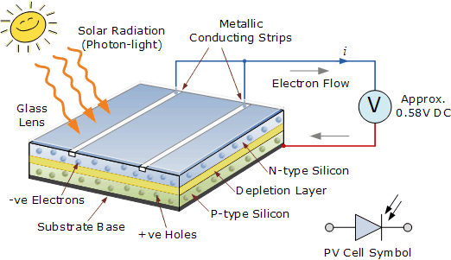
Working of Solar Cell

Slide 11
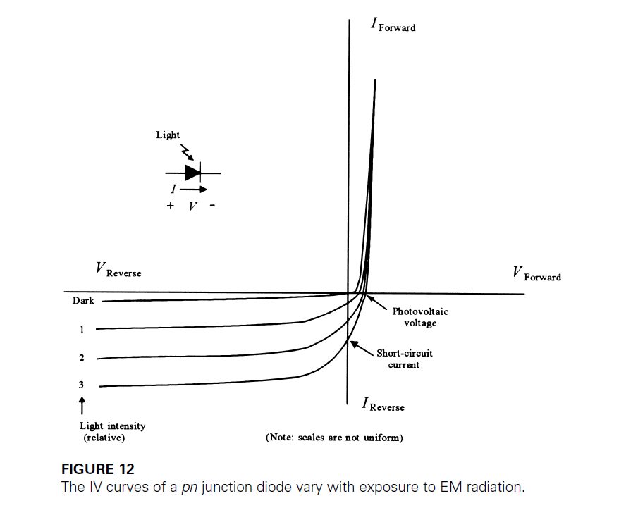
Specifications and Characteristics
Type of Product : | Polycrystalline Solar Panel
Rated Power Range : | 1-30 W
Watt : | 5 W
Voltage at Pmax ( V) : | 17.3 V
Module Voltage : | 12 V

Slide 12
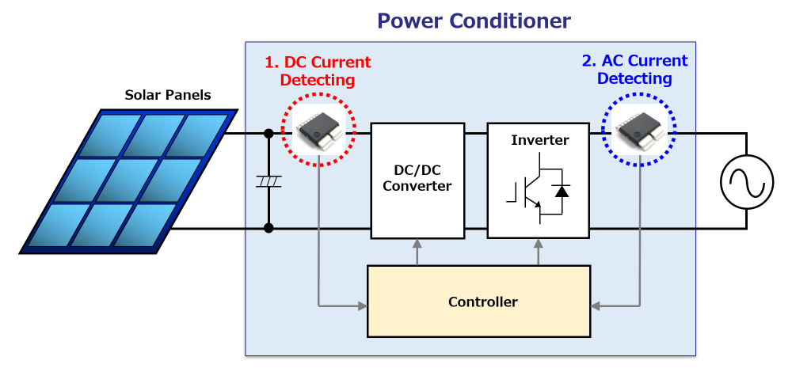
Application of Solar cell
Solar India 5 Watt 12 V Polycrystalline Solar Panel SSI5 Watt by Solar India

Slide 13
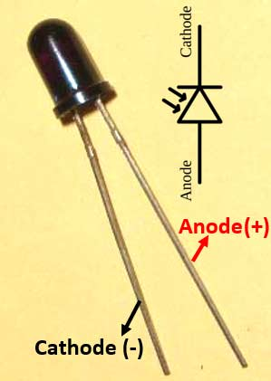
4. Photodiode
Sensitivity: | A measure of the effectiveness of a detector in producing an electrical signal at the peak sensitivity wavelength.
Noise Equivalent Power (NEP): | The power of incident light, at a specific wavelength, required to produce a signal on the detector that is equal to the noise.

Slide 14
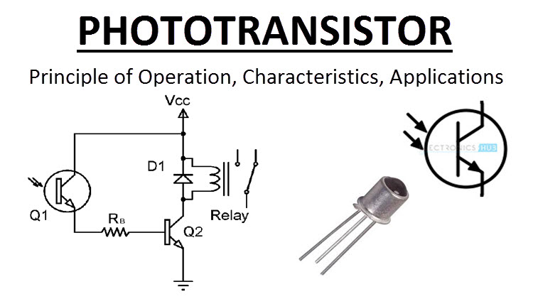

Slide 15
Specifications
Peak wavelength: 940 nm.
Package: Round 5 mm (T-1 3/4)
Lens type: dark plastic to cut visible light.
Viewing angle: 20 degrees.
Voltage - Collector Emitter Breakdown (Max): 30 V.
Current - Collector (Ic) (Max): 3.12 mA.
Current - Dark (Id) (Max): 100 nA.
Power - Max: 100 mW.

Slide 16

Chemical Sensors:
pH is a measure of the acidity or alkalinity of a solution and is expressed on a scale of 0 to 14, with 7 being neutral.
Applications: Chemical, pharmaceutical, food and beverage, and water treatment industries.
A pH measurement consists of pH sensor, which is placed in the solution to be measured, and a signal conditioning circuit, which converts the signal from the sensor into a usable output signal. Types:
Glass electrodes
Ion-selective field-effect transistors (ISFETs).
Differential pH sensors.

Slide 17
Glass electrodes
Glass electrodes are the most commonly used pH sensors.
They consist of a thin glass membrane that is sensitive to changes in pH, and an internal reference electrode.
When the glass membrane comes into contact with a solution, an electrical potential is generated that is proportional to the pH of the solution.
The internal reference electrode provides a stable reference voltage against which the potential of the glass electrode is measured.

Slide 18
Ion-selective field-effect transistors (ISFETs).
ISFETs are a newer type of pH sensor that use a semiconductor junction instead of a glass membrane.
They are smaller and more robust than glass electrodes and can be used in harsh environments.
However, they are more sensitive to interference from other ions in the solution and may require more frequent calibration.
Differential pH sensors use two pH sensors with different sensitivities to measure the pH of a solution.
By subtracting the output signal from the two sensors, the effects of temperature and other interfering factors can be minimized.

Slide 19
The pH rate of a material is directly linked to the degree of the hydrogen ion [H+] and the hydroxyl ion [OH-] concentrations
If the H+ density is higher than OH-, the substance is acidic; i.e., the pH amount is less than 7.
If the OH- intensity is higher than H+, the substance is basic, including a pH value higher than 7.
If identical quantities of H+ and OH- ions are present, the substance is neutral, with a pH of 7.

Slide 20
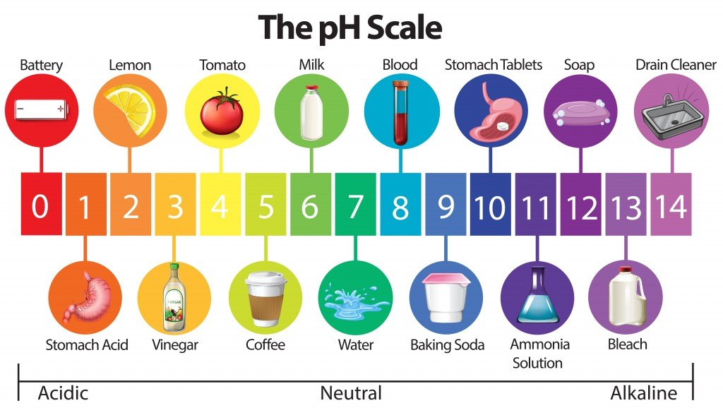

Slide 21
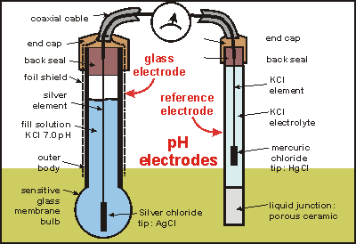
pH Meter Working Principle

Slide 22
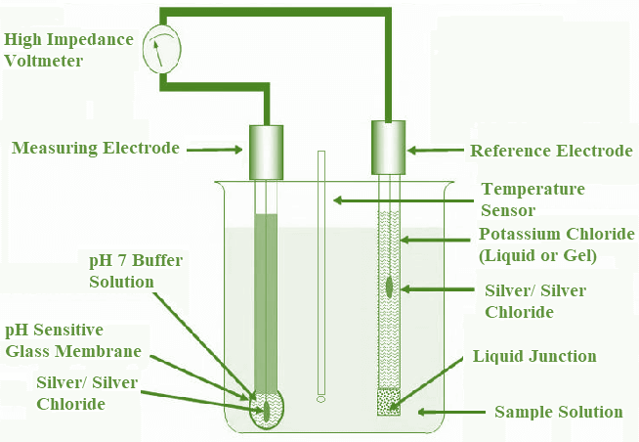
pH Meter Working Principle

Slide 23
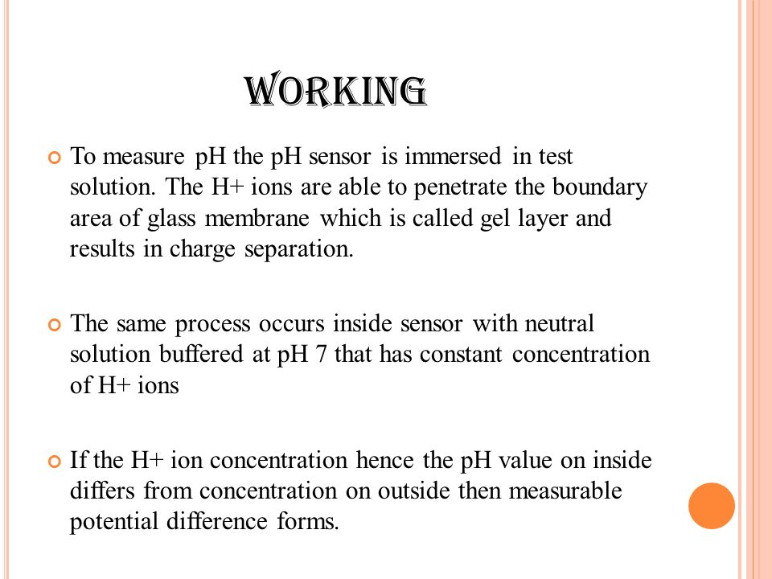

Slide 24
THANK YOU

